Slide 1
The relationship between minimum wage and inequality computationally
Group: new-team
Cheng Chung Yu,
Lee Chun To

Slide 2
Content
Introduction: Income inequeality, minimum wages
Traditional Method: Paper 1 and 2
Computational Method: Background
Computational Method: Advantage and Disadvantage
Conclusion

Slide 3
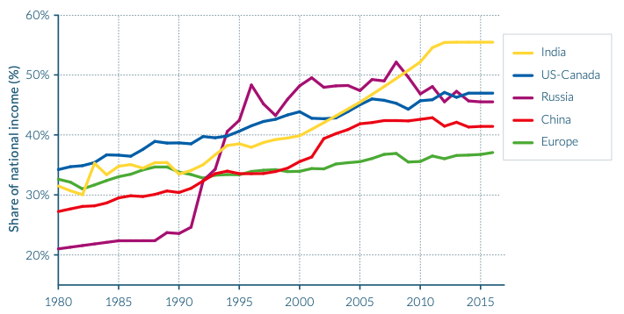

Introduction- Income inequality
Income is household earnings in a particular period
indicators measure inequality : Gini cofficient, S80/S20
worldwide issue, and inevitable

Slide 4

Introduction- minimum wages
pay a certain amount of remuneration
protect workers against unfairly low pay
ensures equitable share of the progress
overcome poverty and reduce inequality

Slide 5
Traditional Method- Paper 1
impact on wage pattern of the national minimum wage (NMW) in the UK
outcomes: NMW does have a noticeable impact on the wage distribution
effect is limited
only 6–7% of workers are directly affected
effect on overall income inequality meagre

Slide 6
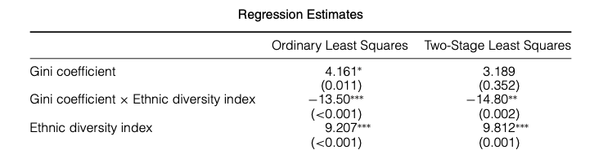
Traditional Method- Paper 1
no detectable influence on earnings at 10%
data evaluates figures of low paid workers violated with the hypotheses
More work to seealternative measures of effect on NMW

Slide 7
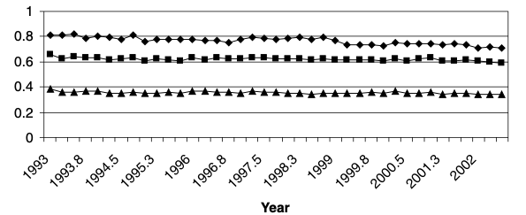
Traditional Method- Paper 2
explore determinants of wage levels in the United States
focus on effects of income inequality and ethnic difference
evaluates the influence of income inequality, ethnic diversity and cooperation

Slide 8
Traditional Method- Paper 2
influence of income inequality negotiated by ethnic diversity
increases income inequality associated with higher state minimum wages when states ethnically homogeneous
negative collision on state minimum wages in heterogeneous states arise in income inequality

Slide 9
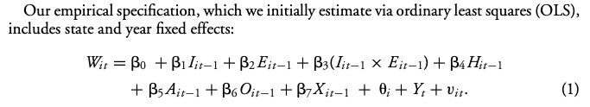
Traditional Method- Analysis
Paper 1 minimum wages used ordinary least squares (OLS)
estimate state and year fixed effects
only OLS and some regression models
only data from US federal

Slide 10
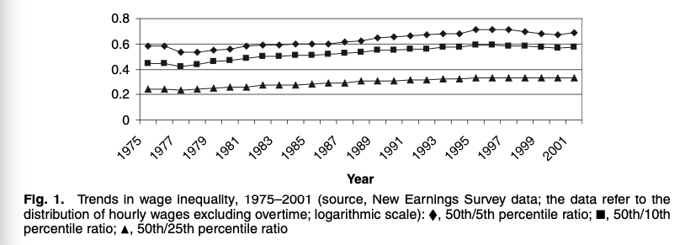
Tradition Method- Analysis
Paper 2 used a lot of second-hand data
used less model to prophesy the long term effect
eliminators that can not be measured

Slide 11
Computational Method- Background
minimum wage, inequality investigate influence the society
improvement in technology expanded the database
access information required to generate useful ideas easily
researchers make predictions about the expected future

Slide 12
Computational Method- Advantages
specifically used to collect objective and irrefutable facts
result analyzed by computational science methods strongly support
participants much more than other methods

Slide 13
Computational Method- Advantages
simulations are essential element
understand system between minimum wage and wealth inequality
simulate a condition that is similar to reality

Slide 14
Computational Method- Shortcomings
requires large amount of data from different databases
build a related database to utilize the research method
Timely responses are problematic
sufficient sample size required to ensure sufficient statistical power

Slide 15
Computational Method- Shortcomings
research cost is relatively higher
difficult to differentiate between accurate, inaccurate data
intrinsic complexity
more challenging to interpret

Slide 16
Conclusion
investigate the relationship between minimum wage and inequality
necessary to make use the traditional social science method
both method have its advantages and limitations
different methods would be adopted to analyze

Slide 17
Conclusion
computational method understand correlations of variables
predict future condition in society
limitations adopted quantitative data is superficial
explanation phenomenon relatively weak
both methods should put together into a complete solution

Slide 18
Thank You

